Slide 1
Focus Projects and HCI

Slide 2
Human Computer Interaction (HCI)
How do regular people use computers?
What do they use them for?
How can we improve everyday lives using computers?

Slide 3
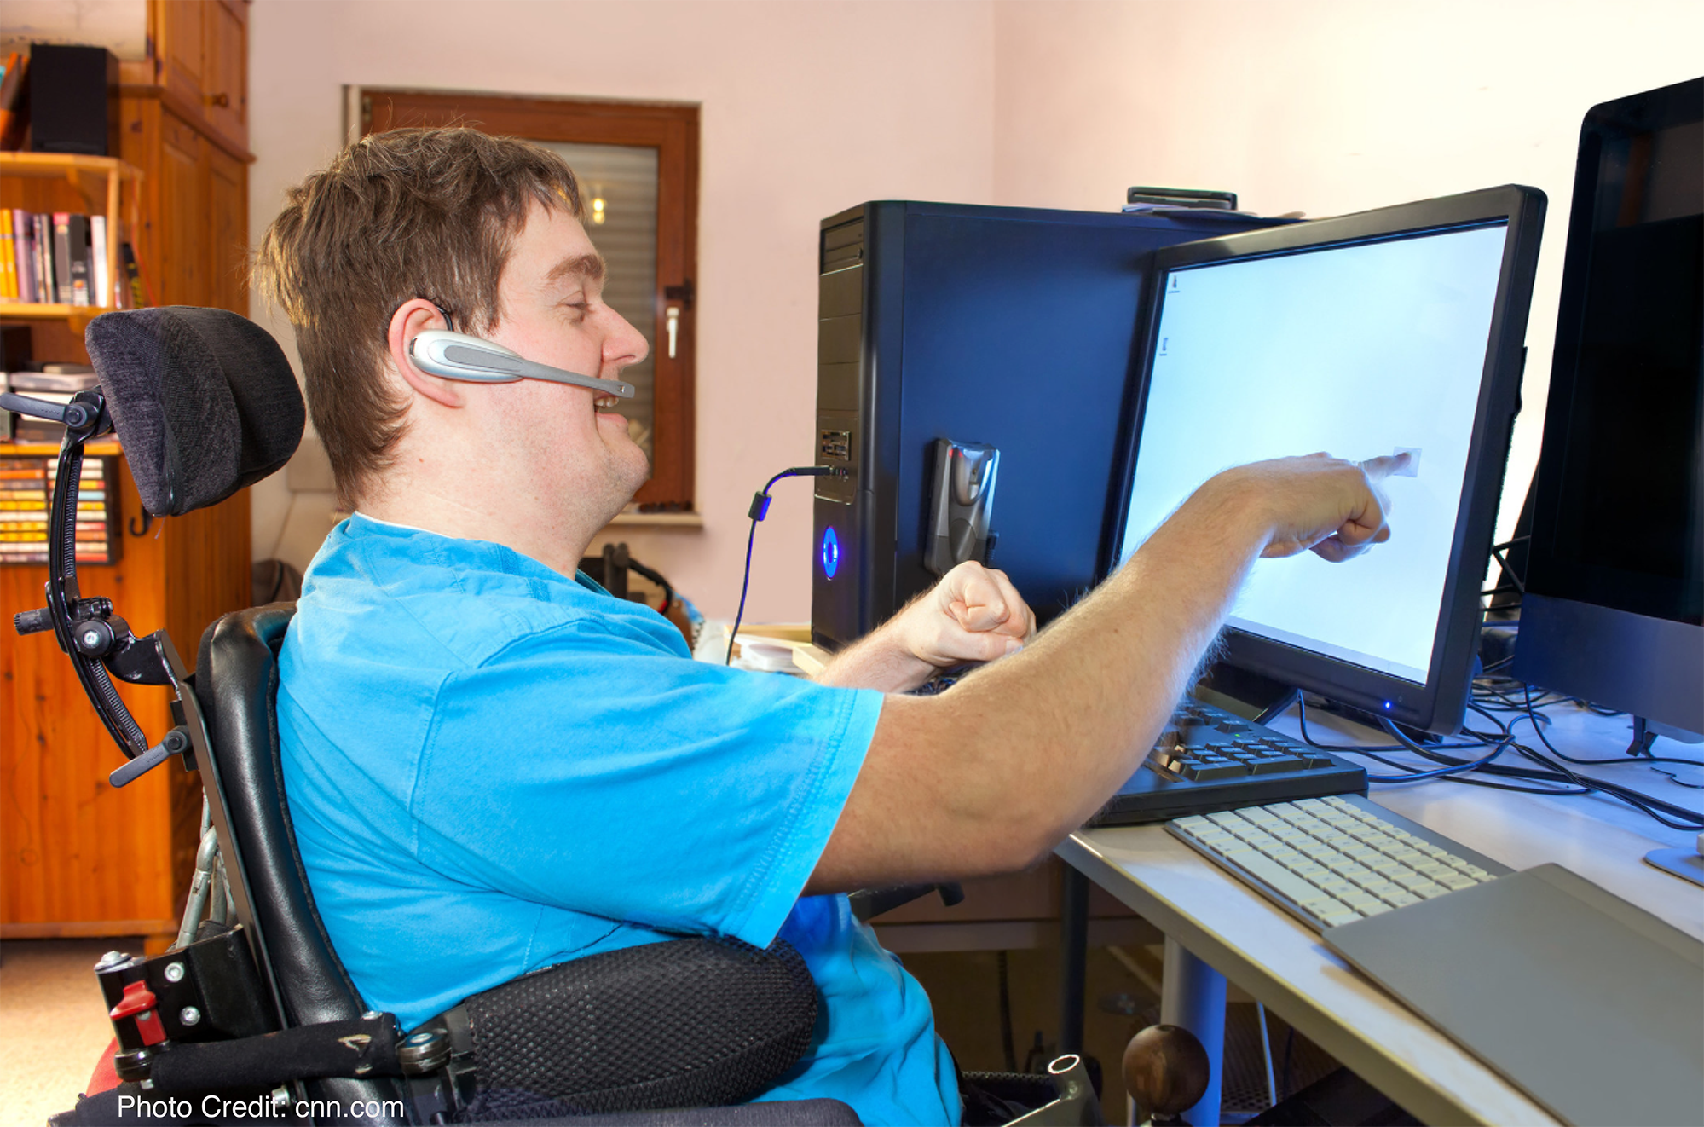
Accessible Technology

Slide 4
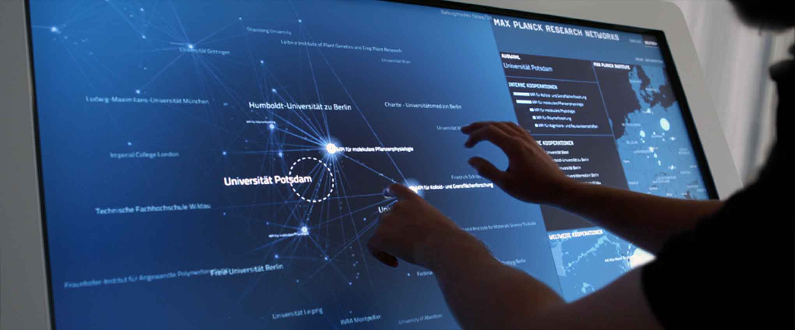
Interface Design

Slide 5

Tech for Developing Countries

Slide 6
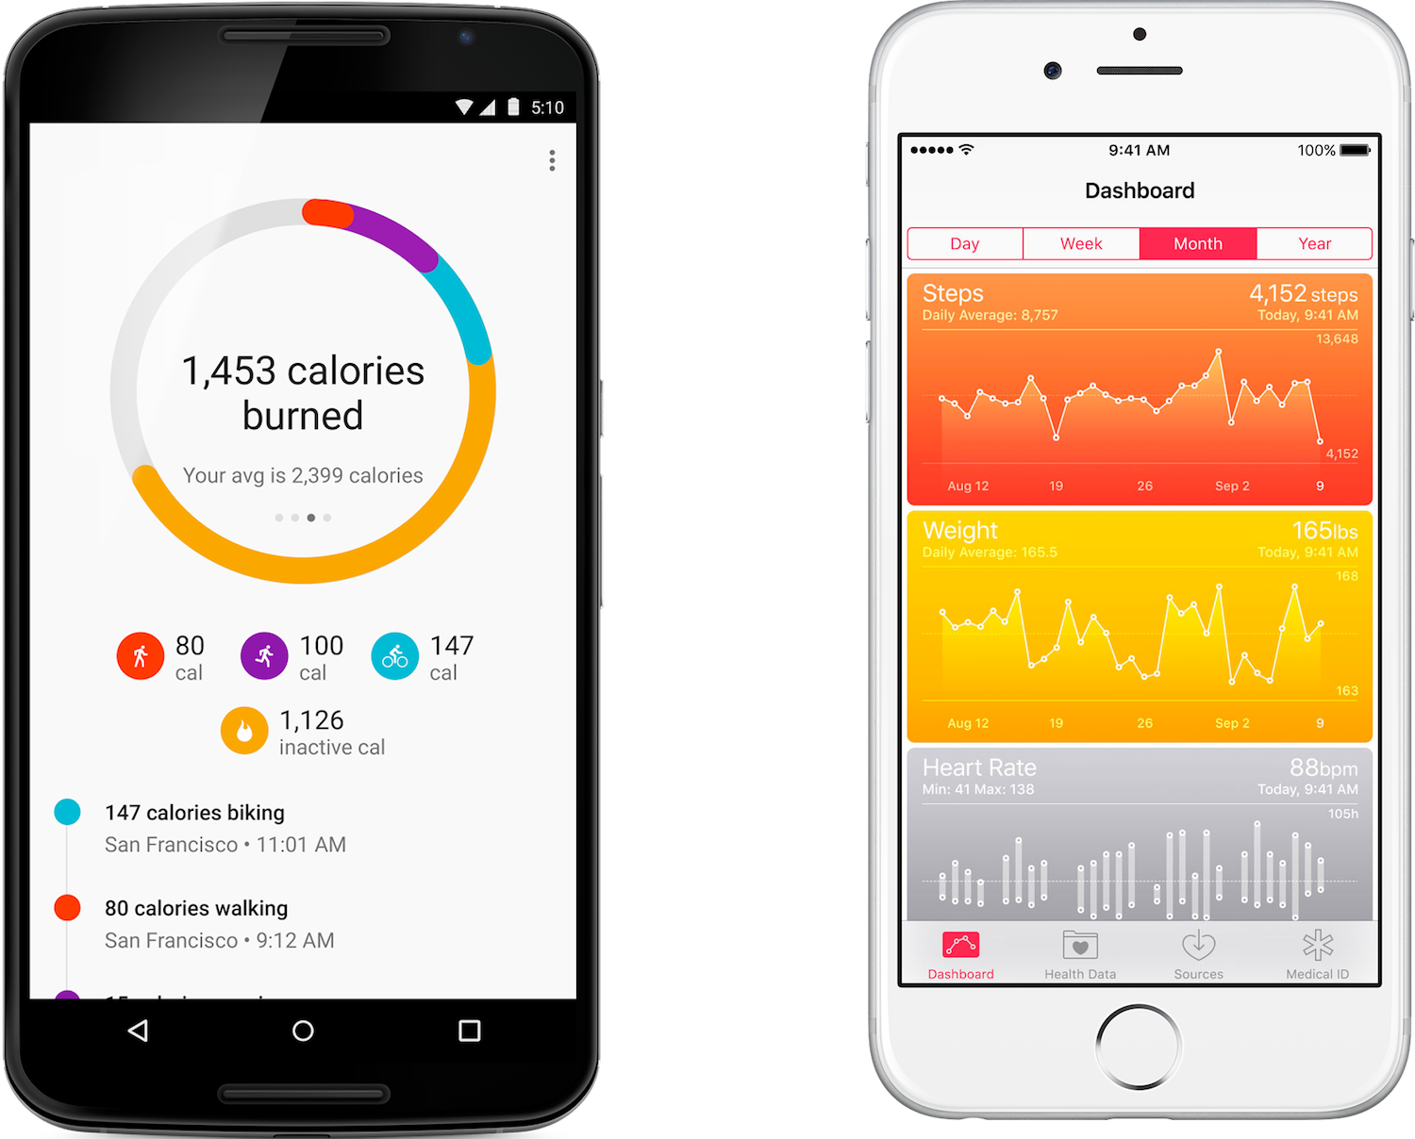
Personal Data Tracking

Slide 7

Education

Slide 8
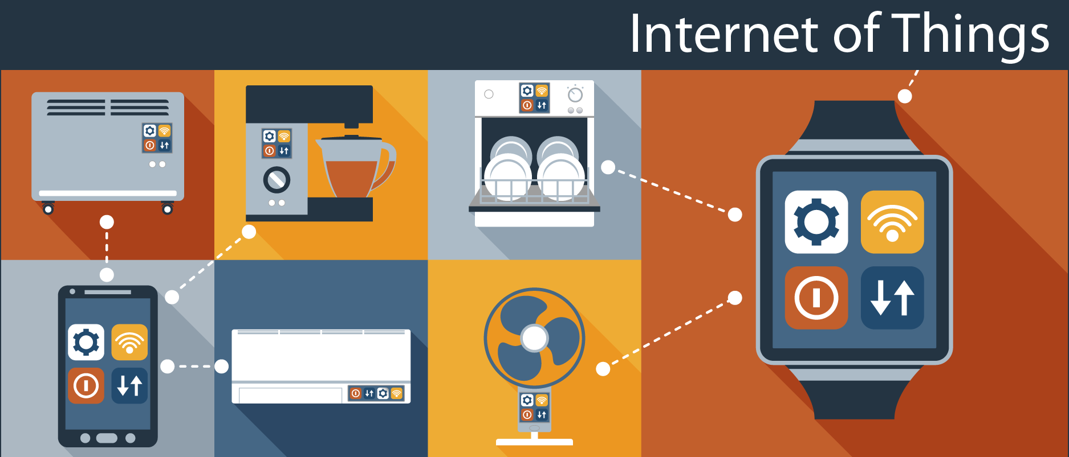
Ubicomp

Slide 9
HCI Design Principles
User-centric
Empirical
Iterative

Slide 10
User-Centric
Who is this for?
What are their needs?
How does this technology meet those needs?
Will this person be able to use this technology?
Don’t just design for yourself!

Slide 11
Empirical
Measurable, consistent feedback and data collection
Pay attention to all the variables
Differences in user background and preference
Environmental influences
and if you were doing this professionally…
Statistical significance
Reproducibility

Slide 12
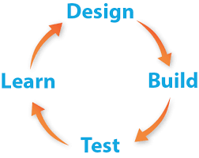
Iterative
Get feedback early and often from multiple people
Don’t expect your first try to be perfect

Slide 13
Weekly Schedule
Tuesday
Brainstorming
Background research
Planning
Wednesday
Iteration (plan + implement + test)
Thursday
Iteration (plan + implement + test)
Friday
Final trials
Presentation writing

Slide 14
Suggested Approaches
Identify a problem and audience, then create a solution to solve it
What can be done in a week?
What else has been done to solve this problem?
What are you doing better/different?
Recreate an existing device’s functionality
What is the purpose of this device?
What can you copy with C.P.’s hardware?
Can you improve it at all?

Slide 15
Some Ideas
Alarm Clock w/ snooze function
Pedometer with daily step goal
Burglar Alarm w/light sensor and disarm code
“iPod” with multiple songs and playback control
Meal tracker w/ calorie input and daily goal

Slide 16
Ideas for ways to interact with Circuit Playground
Use the slide switch to change “modes”
E.g. between input and output
Display numbers in a range by lighting more neopixels up
Could also beep x times to show smaller numbers
Buttons can be used to move cw and ccw over the neopixels
C.P. can tell if both buttons are pressed at the same time
NeoPixels can be used to display binary numbers
Up to 2^11 in theory
The circuit pins can also sense touch
Rob and Google are your friends

